Slide 1
MANAGEMENT OF CATARACT AND COMPLICATIONS
Dr. P Pradeep
Professor
Dept of Ophthalmology

Slide 2
NON SURGICAL MANAGEMENT
TREATMENT OF CAUSE
Adequate control of diabetes mellitus,
Removal of cataractogenic drugs such as corticosteroids, phenothiazenes and strong miotics
Removal of irradiation (infrared or X-rays)
Early and adequate treatment of ocular diseases like uveitis

Slide 3
MEASURES TO DELAY PROGRESSION
Commercially available preparations containing iodide salts of calcium and potassium are being prescribed in abundance in early stages of cataract
Vit E and aspirin
Conclusive results for use are not found
MEASURES TO IMPROVE VISION IN INCIPIENT AND IMMATURE CATARACT
Refraction corrected at frequent intervals
Use of mydriatics in small axial cataracts
Arrangement of illumination-
Peripheral opacities - brilliant illumination
Central opacities - Use of dark goggles

Slide 4
INDICATIONS FOR SURGERY
Visual improvement
Medical indications:
-Lens induced glaucoma
-Phacoanaphylactic endophthalmitis
-Retinal diseases like diabetic retinopathy or retinal detachment
Cosmetic indication in mature cataract with no hope of vision

Slide 5
PREOPERATIVE WORKUP
General examination
Ocular examination
Anterior segment evaluation
Intraocular pressure
Examination of lids, conjunctiva and lacrimal apparatus
Fundus examination
Macular function tests
Evaluation of retina
Keratometry and biometry

Slide 6
Preoperative preparations
Consent
Topical antibiotics 3 days before surgery
Scrub bath and marking of eye
IOP lowering
Mydriasis
ANAESTHESIA
Local anesthesia is preferred
2% Lignocaine with 0.75% Bupivacaine

Slide 7
Surgical cataract extraction
TYPES
Intracapsular cataract extraction (ICCE)
Extracapsular cataract extraction (ECCE)
Conventional ECCE
SICS
Phacoemulsification

Slide 8
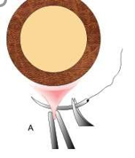
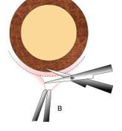
INTRACAPSULAR CATARACT EXTRACTION
It is an important landmark in the history of cataract surgery
The entire cataractous lens along with the intact capsule is removed
It is presently obsolete
Steps
Superior rectus (bridle) suture
Conjunctival flap

Slide 9
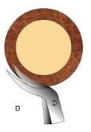
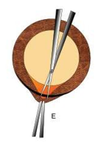
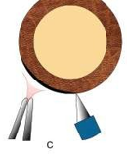
Partial thickness groove/gutter (150º)
Corneoscleral section
Iridectomy

Slide 10
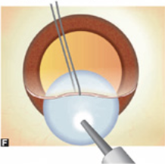
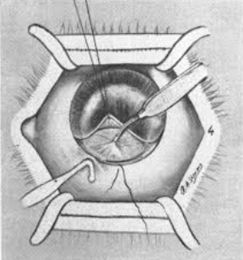
Lens delivery methods
Indian smith method - by tumbling technique
Cryoextraction
Capsule forceps method – using arruga’s forceps
Irisophake method - obsolete
Wire Vectis method – in subluxated and dislocated lens

Slide 11
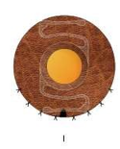
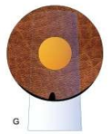
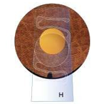
Formation of Anterior Chamber
Implantation of anterior chamber IOL(ACIOL)
Closure of incision- 5-7 interrupted sutures (nylon)
Conjunctival flap reposited and secured
Subconjunctival injection-dexamethasone 0.25ml and gentamicin 0.5ml given
Patching of the eye

Slide 12
EXTRACAPSULAR CATARACT EXTRACTION
Major portion of anterior capsule with epithelium, nucleus and cortex are removed; leaving behind intact posterior capsule.
Posterior chamber IOL can be placed in the remaining capsular bag
Types
Conventional ECCE
Manual SICS
Phacoemulsification

Slide 13
CONVENTIONAL ECCE
Superior rectus (bridle) suture
Conjunctival flap (fornix based)
Partial thickness groove/gutter
Entry into anterior chamber
Injection of viscoelastic substance in anterior chamber - 2% MethylCellulose or 1% Sodium Hyaluronate (Maintains anterior chamber and protects endothelium)

Slide 14
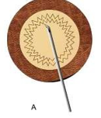
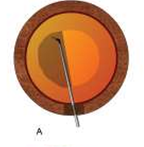
Anterior capsulotomy
Can-opener's technique
Linear capsulotomy (Envelope technique)
Continuous circular capsulorrhexis (CCC)
Removal of anterior capsule
Completion of corneoscleral section
Hydrodissection

Slide 15
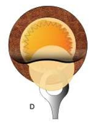
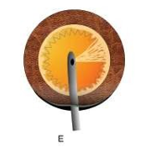
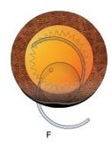
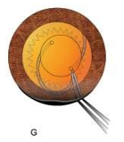
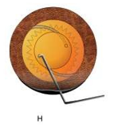
Removal of nucleus
Pressure and counter-pressure method
Irrigating wire vectis technique
Aspiration of the cortex
Implantation of IOL

Slide 16
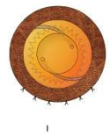
Closure of the incision - 3-5 interrupted sutures
Removal of viscoelastic substance
Conjunctival flap is reposited and secured
Subconjunctival injection
Patching of eye

Slide 17
MANUAL SMALL INCISION CATARACT SURGERY (SICS)
Superior rectus suture
Conjunctival flap and exposure of sclera
Haemostasis
Sclero corneal tunnel incision:
External scleral incision - 5.5mm to 7.5mm
Sclero corneal tunnel - 1-1.5mm
Internal corneal incision
Side port entry

Slide 18
Anterior capsulotomy - can be can-openers,envelope or continuous circular capsulorrhexis (CCC)
Hydrodissection
Nuclear management
prolapse of nucleus into ant chamber
delivery of nucleus through corneoscleral tunnel
Aspiration of cortex
IOL implantation
Removal of viscoelastic material
Wound closure

Slide 19
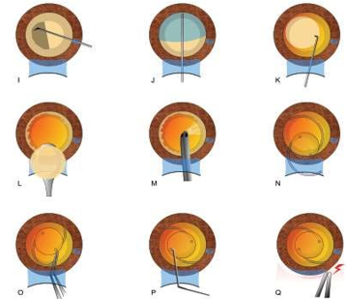

Slide 20
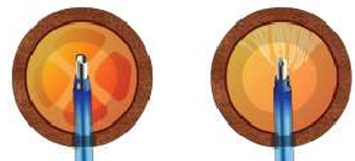
PHACOEMULSIFICATION
STEPS
Corneoscleral incision-very small 3mm
Continuous curvilinear capsulorrhexis of 4-6mm
Hydrodissection
Nucleus is emulsified and aspirated
Remaining cortical lens matter is aspirated
IOL Implantation
Removal of viscoelastic material
Wound closure

Slide 21
ECCE FOR CHILDHOOD CATARACT
Surgical techniques employed for childhood cataract are essentially of two types:
Irrigation and aspiration of lens matter
Lensectomy
Irrigation and aspiration of lens matter:
Steps are same as SICS
In addition, Posterior capsulorrhexis of about 3-4 mm size recommended in children to avoid posterior capsule opacification and Anterior vitrectomy done
Heparin or fluorine coated PMMA IOL is preferred in children.

Slide 22
LENSECTOMY
Lensectomy in children is performed under general anaesthesia
Most of the lens including anterior and posterior capsule along with anterior vitreous are removed with the help of a vitreous cutter, infusion and suction machine
In very young children primary IOL implantation is not planned

Slide 23
Complications of cataract surgery
They are enumerated as
Preoperative complications
Operative complications
Early postoperative complications
Delayed (late) postoperative complications
IOL-related complications

Slide 24
PREOPERATIVE COMPLICATIONS
Anxiety
Nausea & gastritis
Allergic conjunctivitis
Corneal abrasion
Local anaesthesia complications
Retrobulbar haemorrhage
Oculocardiac reflex
Perforation of globe
Subconjunctival haemorrhage
Spontaneous dislocation of lens

Slide 25
OPERATIVE COMPLICATIONS
Superior rectus muscle laceration and/or haematoma
Excessive bleeding during conjunctival flap or incision
Incision related complications
Irregular incision in conventional ECCE
In manual SICS and phacoemulsification
Button holing of tunnel – abandon and dissect at a deeper plane
Premature entry into anterior chamber – stop and new dissection at a lesser depth
Scleral disinsertion – managed by radial sutures

Slide 26
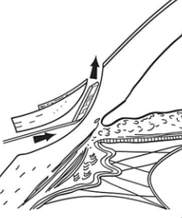
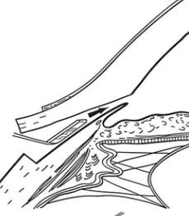
Buttonholing of anterior wall of tunnel
Premature entry into anterior chamber

Slide 27
Injury to the cornea (Descemet's detachment), iris and lens
Iris injury and iridodialysis
Complications related to anterior capsulorrhexis
Escaping capsulorrhexis
Small capsulorrhexis – predisposes to Posterior Capsule tear, Nuclear drop, zonular dehiscence. Managed with relaxing incisions
Very large capsulorrhexis
Eccentric capsulorrhexis

Slide 29
Posterior capsular rupture
Zonular dehiscence
Vitreous loss
Prevented preoperatively by decreasing aqueous, orbital and vitreous volume and better ocular akinesia
Managed by partial anterior vitrectomy
Nucleus drop into the vitreous cavity
Posterior loss of lens fragments
Expulsive choroidal hemorrhage

Slide 30
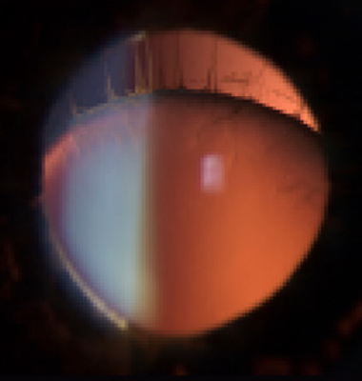
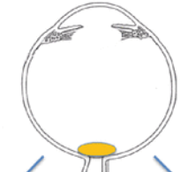
Nucleus drop into vitreous cavity
Zonular dehiscence

Slide 31
EARLY POSTOPERATIVE COMPLICATIONS
HYPHAEMA – mostly absorbs spontaneously. IOP should be lowered
IRIS PROLAPSE – should be reposited and wound sutured
STRIATE KERATOPATHY – due to mild corneal oedema with Descemet’s folds
FLAT ANTERIOR CHAMBER
With wound leak is associated with hypotony
Ciliochoroidal detachment – cured with presuure bandage
Pupil block due to vitreous bulge – managed with mydriatic, hyperosmotic agents

Slide 32
Hyphema
Iris prolapse
Striate keratopathy

Slide 33
POST OPERATIVE ANTERIOR UVEITIS managed with topical steroids, cycloplegics and NSAIDS
TOXIC ANTERIOR SEGMENT SYNDROME
BACTERIAL ENDOPHTHALMITIS – most dreaded complication
generally presents within 48-72 hrs
Intravitreal antibiotics are advised

Slide 35
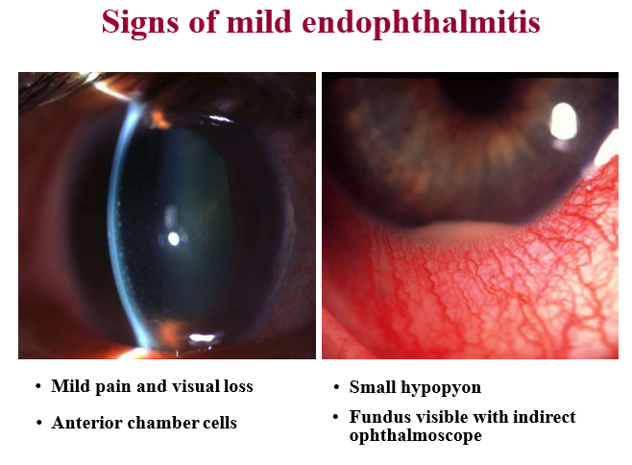

Slide 36
LATE POSTOPERATIVE COMPLICATION
CYSTOID MACULAR OEDEMA
DELAYED CHRONIC POSTOPERATIVE ENDOPHTHALMITIS
PSEUDOPHAKIC BULLOUS KERATOPATHY
RETINAL DETACHMENT
EPITHELIAL INGROWTH
FIBROUS DOWNGROWTH
AFTER CATARACT
GLAUCOMA

Slide 37
CYSTOID MACULAR OEDEMA
Honeycomb appearance on fundus
Flower petal pattern on fluorescein angiography
Use of antiprostaglandin eyedrops as prophylaxis
PSEUDOPHAKIC BULLOUS KERATOPATHY is an indication for penetrating keratoplasty
EPITHELIAL INGROWTH lines the back of cornea and trabecular meshwork as a membrane causing intractable glaucoma
FIBROUS DOWNGROWTH causes secondary glaucoma and ultimately phthisis bulbi

Slide 38
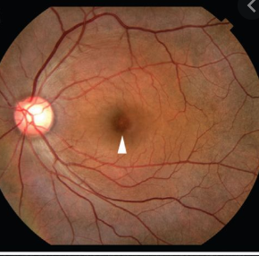
Cystoid Macular Edema - FFA

Slide 39
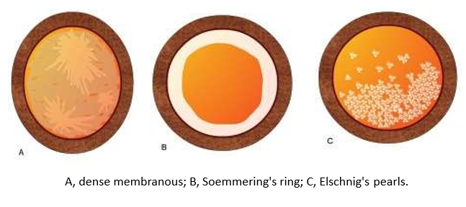
AFTER CATARACT
It is the opacity persists or develop after ECCE
Causes – a) residual opaque lens matter
b) proliferative type from left-out anterior epithelial cells
Clinical types
Soemmering’s ring
Elshnig’s pearls
Dense membranous

Slide 40
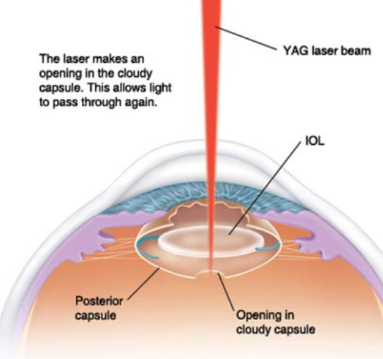
After cataract is managed as follows
Best treated by Nd-YAG capsulotomy
Discission with cystitome or zeigler’s knife
Dense membranous type needs surgical membranectomy
Soemmering’s ring with clean central PC needs no treatment
Elschnig’s pearls – Nd-YAG laser or cystitome discission

Slide 41
IOL RELATED COMPLICATIONS
MALPOSITION OF IOL
Sun-set syndrome
Sun-rise syndrome
Lost lens syndrome
Windshield wiper syndrome
PUPILLARY CAPTURE OF THE IOL following postoperative iritis
TOXIC ANTERIOR SEGMENT SYNDROME - excited by either ethylene gas used for sterilising IOLs or by the lens materials
UGH syndrome- Uveitis Glaucoma Hyphema syndrome. Occurs with rigid ACIOLs which are not in use now

Slide 42
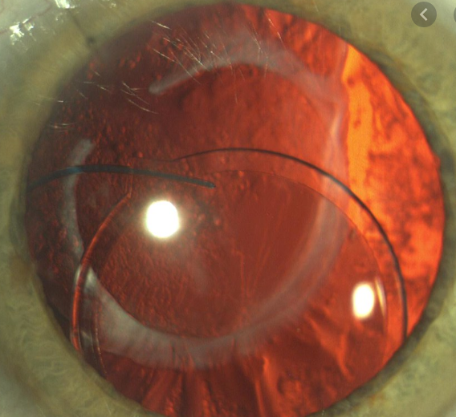
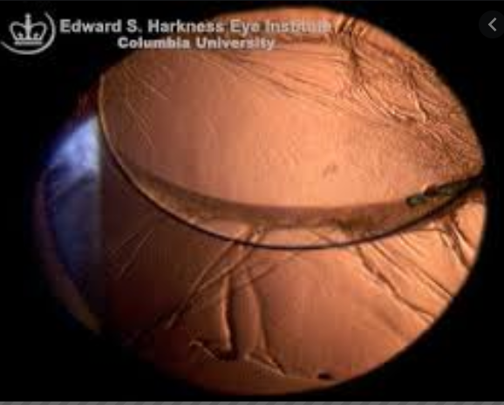
Sun-set syndrome
Sun-rise syndrome

Slide 43
THANK YOU

